Slide 1
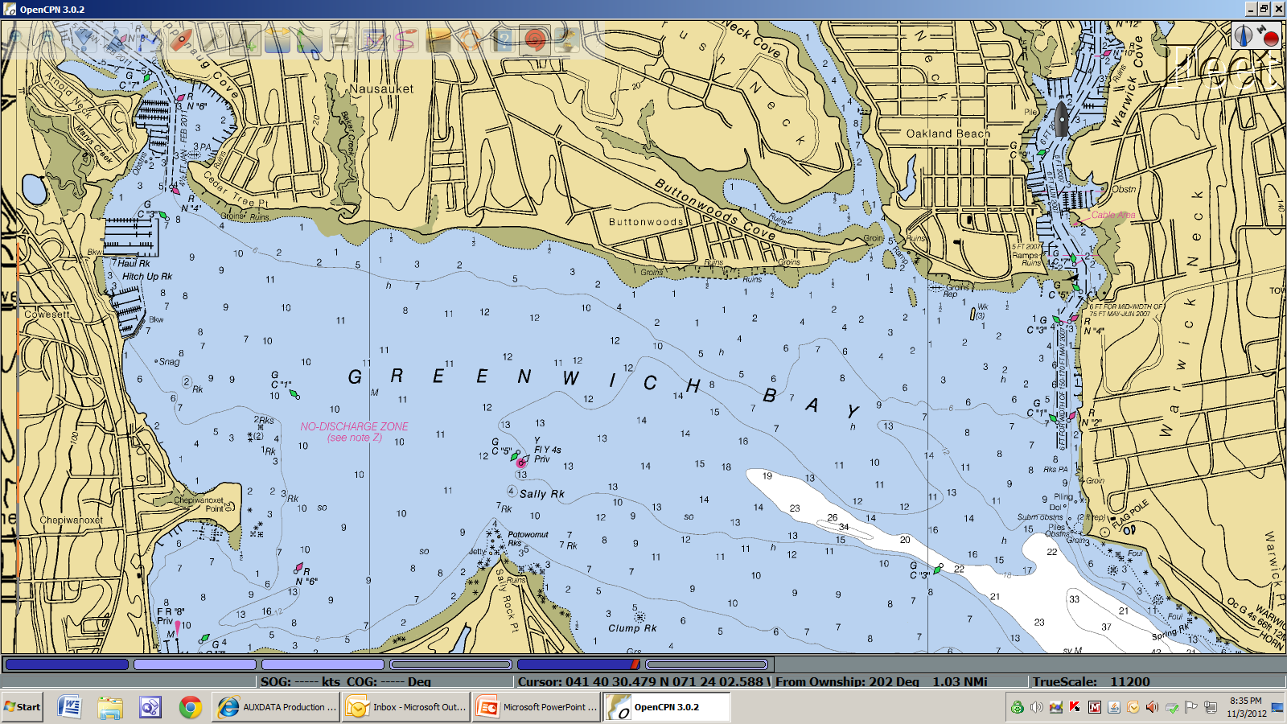
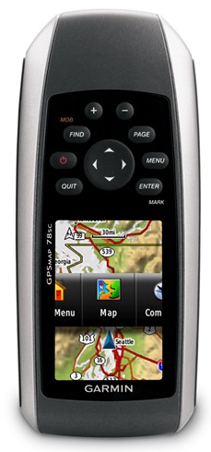
Tonight’s Topics: www.uscgaan.com Website Resources
Garmin GPS 78S (D1N GPS Units) and cover WAAS
Google Earth – Use and NOAA Chart Overlay
OpenCPN basic use for Navigation Systems work
OpenCPN Object Search
Use: Waypoints, Tracks, PATON and Light List GPX files
Viewing of ENC and RNC Charts and chart groups
Importing Garmin GPS 78 Waypoints and Tracks to OpenCPN and Google Earth for accuracy check
WELCOME – NS WebEx Training
Garmin 78S GPS
Google Earth / NOAA Overlay
OpenCPN – Use for the NS program
WWW.USCGAAN.COM then click on OpenCPN tab
Practical use of these tools for NS Work

Slide 2
OpenCPN
Open Source Chart Plotter Navigation Software
A Chartplotter and GPS Navigation Software
OpenCPN is a free software project to create a concise chart plotter and navigation software, for use underway or as a planning tool and chart viewer. OpenCPN is developed by a team of active sailors using real world conditions for program testing and refinement.
www.opencpn.org

Slide 3
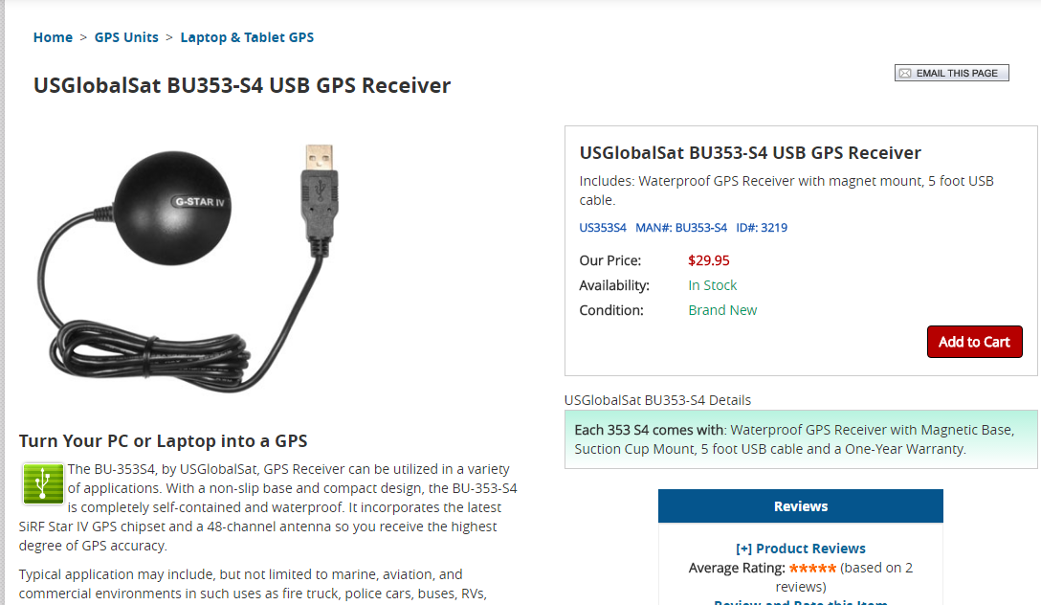
With the addition of a GPS dongle, OpenCPN moves from a chart viewer to a powerful chart plotter

Slide 4
OpenCPN uses some basic settings or limitations.
Courses are by default true, not magnetic, config-able.
Distances are measured in Nautical Miles (meters for very short distances, less than a cable or 0.1 mile).
Feet= Meters X 3.28
All distances and routes are calculated using Mercator Sailing, not Great Circle Sailing.
Knots is used for speed.
These fundamental settings cannot be changed.
OpenCPN
A Chartplotter and GPS Navigation Software

Slide 5
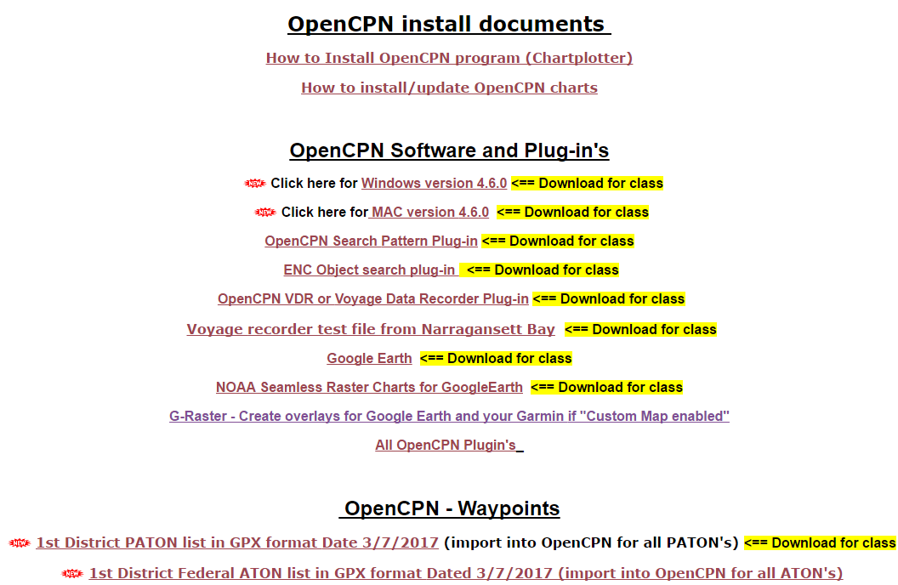
April 18, 2017 WebEx
Go to USCGAAN.COM click on the OpenCPN tab and download items marked below

