Slide 1
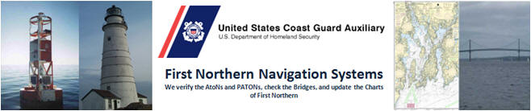
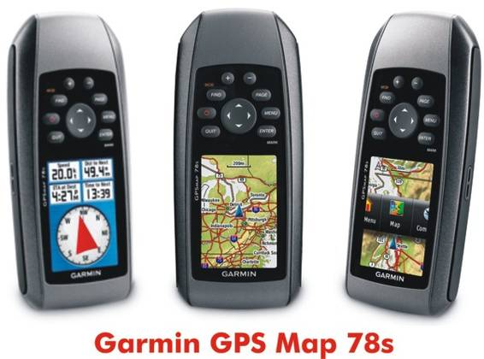
Mike Quinn – ADSO-Narragansett Bay – michaelsquinn@gmail.com

Slide 2
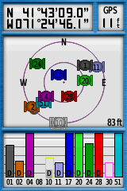
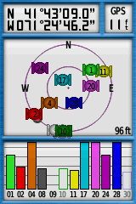
Which position is most accurate?

Slide 3
(WAAS) Wide Area Augmentation System
WAAS uses a network of ground-based reference stations, in North America and Hawaii, to measure small variations in the GPS satellites' signals in the western hemisphere. Measurements from the reference stations are routed to master stations, which queue the received Deviation Correction (DC) and send the correction messages to geostationary WAAS satellites in a timely manner (every 5 seconds or better). Those satellites broadcast the correction messages back to Earth, where WAAS-enabled GPS receivers use the corrections while computing their positions to improve accuracy.
The Garmin GPS 78s has a patch antenna so hold it horizontal!
If you have a device with a quadrifilar helix antenna hold your GPS vertical.

Slide 4
How do you know WAAS is active?

Slide 5
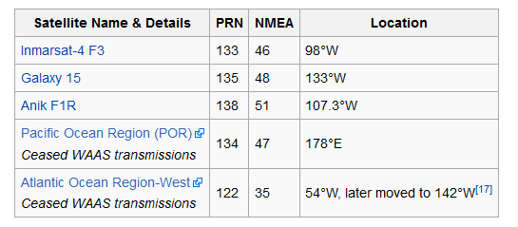
Where are our WAAS Satellite’s
United Kingdom
United Kingdom
United States
Canada
Canada

Slide 6
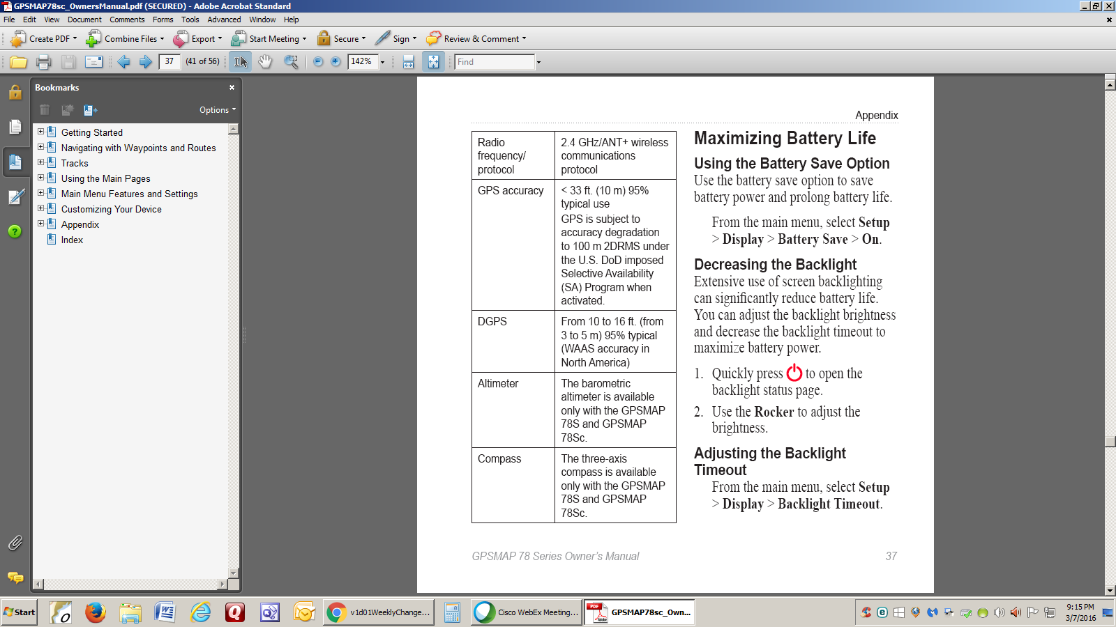
GARMIN GPS 78 Spec sheet
NSTB's actual finding
FAA's National Satellite Test Bed
GPS Measured | 8.2 ft / 15.4 ft | The actual measured accuracy of the system (excluding receiver errors), with SA turned off, based on the findings of the FAA's National Satellite Test Bed, or NSTB.
WAAS Measured | 2.9 ft / 4.3 ft | The actual measured accuracy of the system (excluding receiver errors), based on the NSTB's findings.
We use only use WAAS enabled devices because it supports our NS goal of prevention, accuracy, credibility, professionalism and service to the Coast Guard

Slide 7
Current and Future Satellite Navigation Systems
Navstar GPS (U.S.): 24 + 3 satellites for global coverage; fully operational since 1995; used in billions of devices worldwide. Navstar = Navigation System Using Timing and Ranging.
GLONASS (Russia): 24+ satellites for global coverage; fully operational since 2011; in widespread use today to augment GPS coverage. Glonass = Global Navigation Satellite System.
BeiDou (China): 35 satellites for global coverage by 2020; regionally operational since 2011.
Galileo (Europe): 27+ satellites for global coverage by 2019; designed to work with GPS; 6 satellites on-orbit today.
QZSS (Japan): 4+ satellites for regional coverage by 2018; designed to work with GPS; 1 satellite operational today.
IRNSS (India): 7 satellites for regional coverage by 2015; 3 satellites operational today.

Slide 8
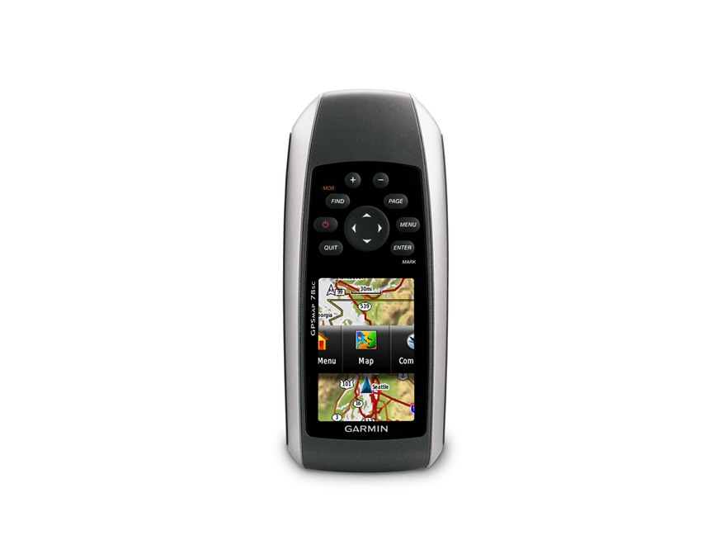
Buttons

Slide 9
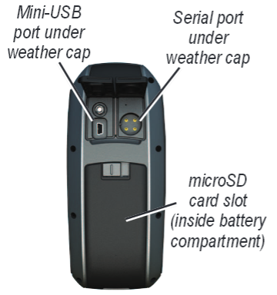

Slide 10
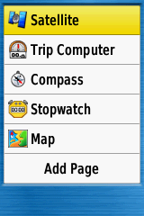
Tools for your use

Slide 11
Tools for your use – Most Important Satellite

Slide 12
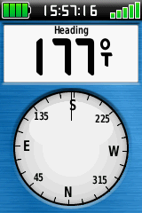
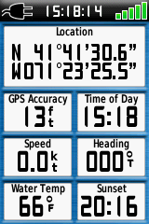
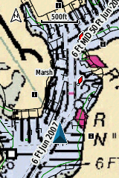
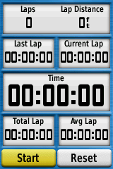
Map (Chart)
Stop Watch
Compass
Trip Computer

Slide 13
Correct setup of the GPS

Slide 14
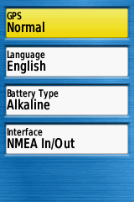
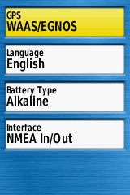
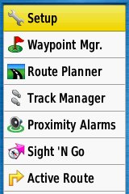
How to Enable WAAS – off by default
European Geostationary Navigation Overlay Service (EGNOS)

Slide 15
How do you know WAAS is active?

Slide 16
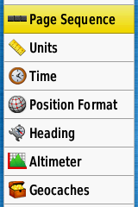
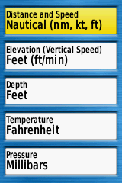
UNITS

Slide 17
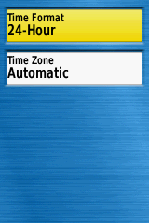
TIME

Slide 18
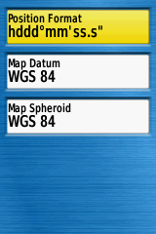
Position Format and Map Datum WGS 84
World Geodetic System 1984
North American Datum 1983

Slide 19
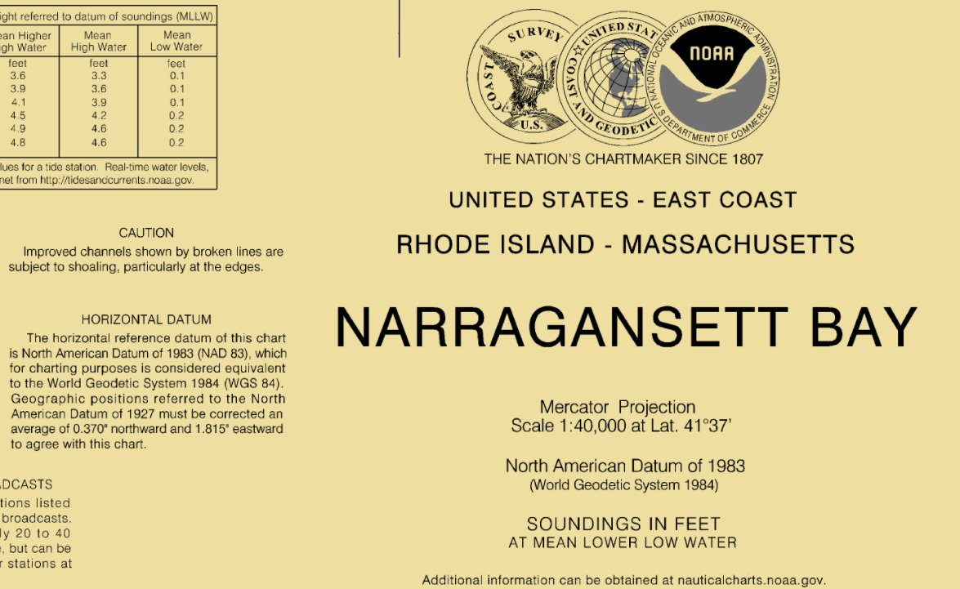
The coordinate origin of WGS 84 (NAD 83) is meant to be located at the Earth's center of mass; the error is believed to be less than 2 cm
The readjustment of the North American Datum of 1927 (NAD 27), Old Hawaiian Datum and Puerto Rico Datum to the North American Datum of 1983 (NAD 83 (1986)) in July 1986 was both a change in reference ellipsoid and a "clean up" of nearly 200 years of surveying data held by NGS. Based on this readjustment and redefinition, positions of points can change between 32- 328 feet, in the conterminous United States, more than 656 feet in Alaska, Puerto Rico and the Virgin Island and in excess of 1312 feet in Hawaii.

Slide 20
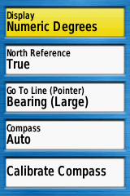
HEADING

Slide 21
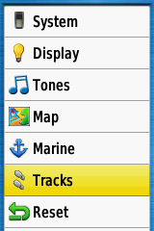
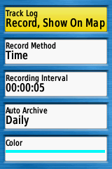
How to setup precise tracking and daily archiving

Slide 22
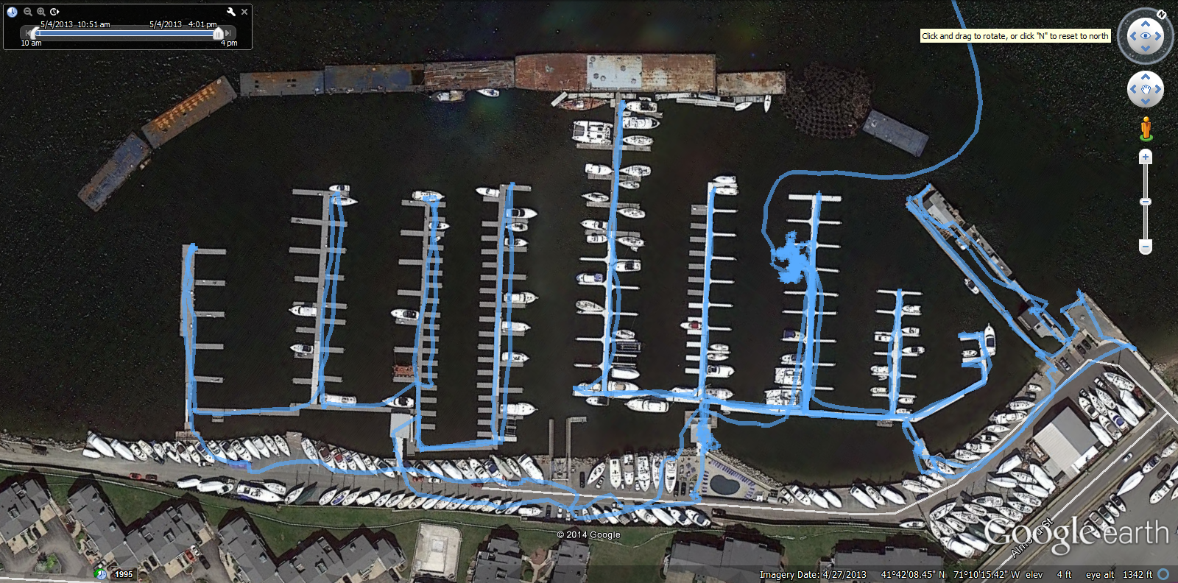
High accuracy track allows you to check your work

Slide 23
MARK / ENTER
For Waypoints at current position
Most important and used feature on the GPS for NS work!

Slide 24
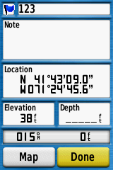
Waypoint number
Waypoint Location
By pressing done it will save the waypoint

Slide 25
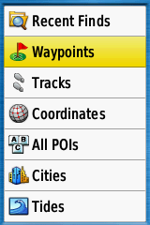
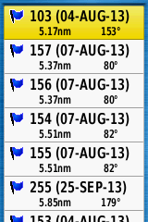
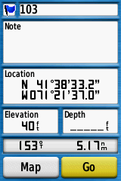
Find or Menu to review waypoints
Find is MOB if held

Slide 26
QC Hint:
Always leave the GPS on the Satellite page to mark your positions
Confirm EPE is still under 20 (how you hold the GPS). This will allow you to verify WAAS is still actively correcting your position (Deviation correction is applied)
Mark and MOB feature work from this screen.

Slide 27
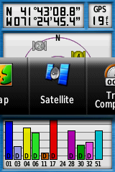
PAGE BUTTON

Slide 28
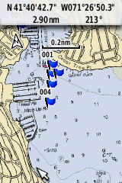
MAP DISPLAY

Slide 29
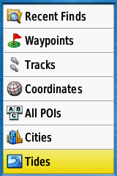
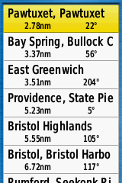
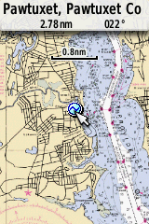
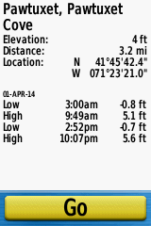
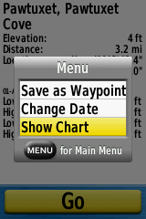
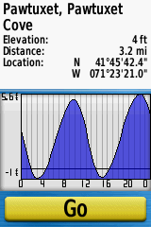
Tides

Slide 30
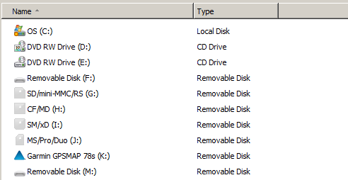
Where are the files?

Slide 31
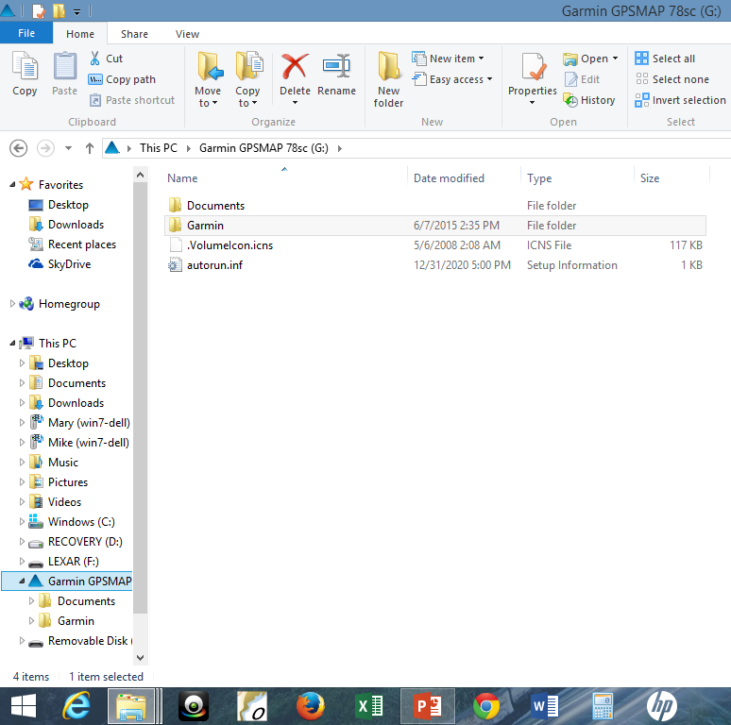
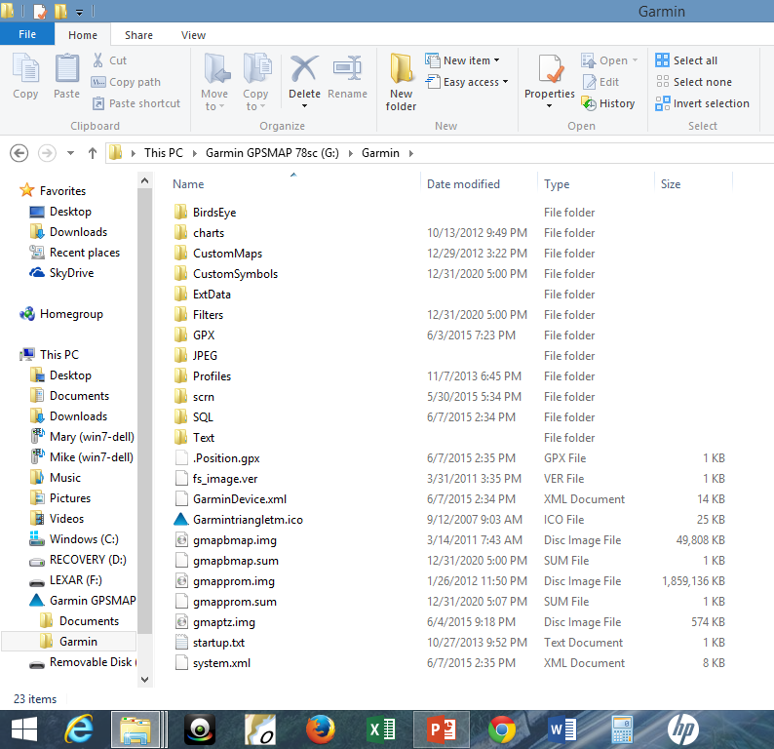
Where you find your Tracks and Waypoints

Slide 32
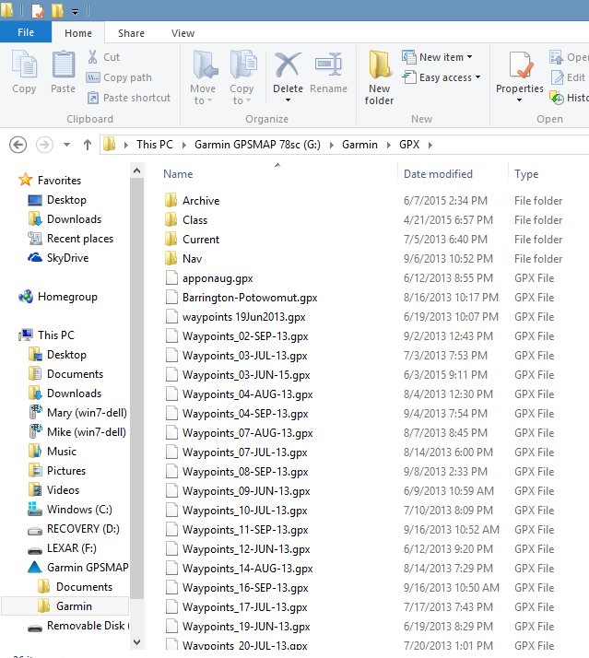
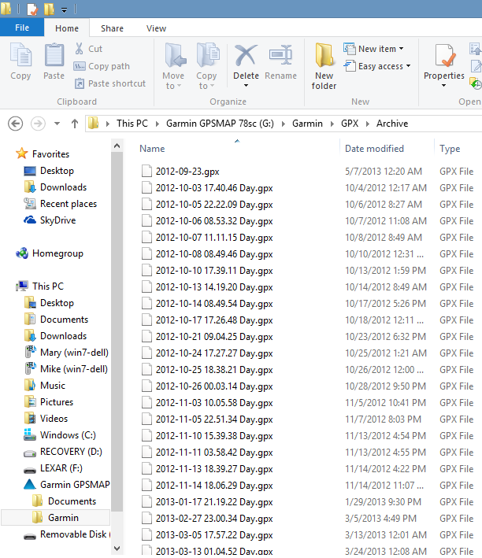
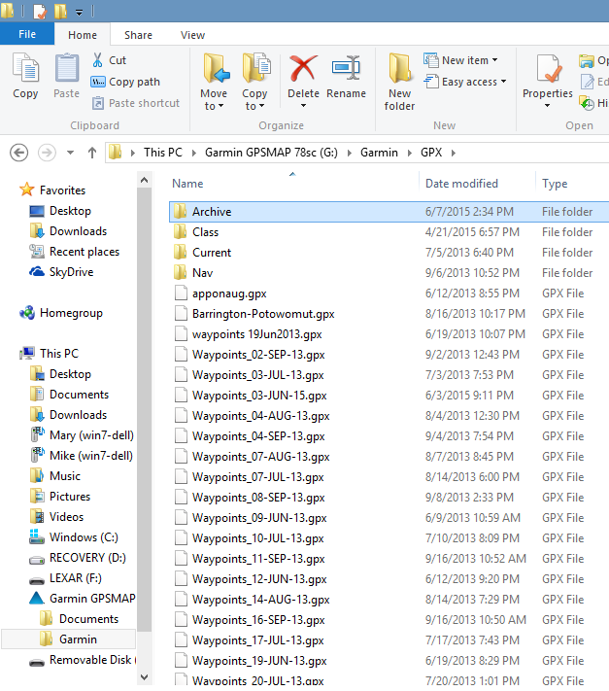
Waypoints
Tracks
Waypoints and Tracks

Slide 33
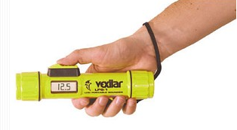
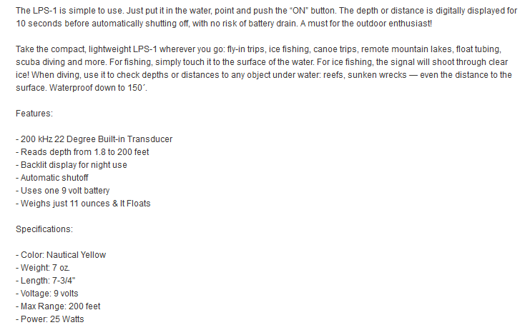

Slide 34
QUESTIONS?
Mike Quinn – ADSO-Narragansett Bay – michaelsquinn@gmail.com

