Slide 1

Navigation Systems
This PATON is Watching Properly?
with voice over on each slide.
Click on the icon to hear the presentation after you read the slide
Prepared by the Navigation Systems Staff of First Northern, USCG Auxiliary for the First District PATON - Private Aids to Navigation - Training Program.
Notes:
Reporting a private aid as watching properly is often a large stretch of faith.
You have to be very sure before you answer Yes to this question on the 7054 AV Verification Report.
Pay close attention to this presentation for it may save you some embarassment in the future.

Slide 2
What do you mean when you check off this statement?
You are telling the Coast Guard that everything is perfect about the PATON that you have reported.
Many readers of your report, due to their busy CG schedules, may not read further than this statement and just file your report. This is their action flag.
The following observations and checks are assumed to have been performed by you when you respond with a YES to this question.
Notes:
This is the summary of the specific meaning of this question.
Basically, you are telling the CG ANT and the Owner that everything is perfect about the private aids that you just observed and reported.
The following training slides will explain the assumptions that the readers of your report believe that you are reporting.

Slide 3
You are certifying that there are no documentation errors in the PATONs permit.
The primary data source for a private aid to navigation are the specifications in the PATON’s record on the PATON System.
Therefore, you are certifying that the plotted observation of the PATON, the Light List data and the charted position, including the symbols and abbreviations, reflects the information on the PATON’s specifications as shown in the PATON System..
Notes:
First, you are reporting that there are no specification errors in the PATONs permit.
The latest specifications appear at the left hand side of the 7054 AV Verification Report until the column heading of “Permitted.” The is the primary source of correct information for a PATON. The observation of the aid, the Light List and the abbreviation and symbols and the Latitude and Longitude as charted must match the PATON’s permit.
When there is an observed difference, you have documentation errors to report.

Slide 4
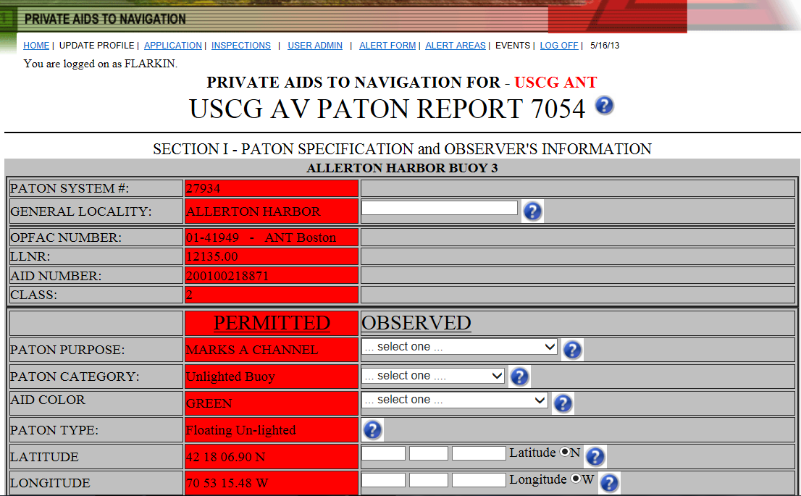
The latest and most current
Specifications for a PATON.
Notes:
This slide shows you where to find the latest specifications for a PATON.
This is an on-line system so you are viewing what actually exists in the PATON’s record when you accessed the PATON.

Slide 5
You are certifying that you observed no physical discrepancies on the PATON.
In your professional opinion:
The PATON has all of its numbers or letters.
The shape is right.
If lighted, the light color is correct;
The light is operating to its specified characteristic and light period.
The aid is not off station and is marking the best water.
Notes:
You are certifying that you observed no physical discrepancies on the PATON based on the specifications showing in the PATON’s record.
All of the numbers or letters on the aid are correct.
The shape of the aid is correct.
If lighted, the light color is correct
If lighted, the light is operating to its specified characteristics and period.
Also, the aid is not off station. It is within the “Off Station” criteria for its type.
Fixed aids are within 25 feet of its permitted position.
Lateral floating aids are within 50 feet of its permitted position.
Floating Regulatory buoys are within 300 feet of its permitted position.

Slide 6
For PATONs that are listed in the Light List, you are certifying that the data in the Light List describes this aid perfectly as observed and as compared to its permitted specifications.
The PATON will have a LLNR - Light List Number.
Note that some Class III PATONs with LLNRs may not be listed nor charted.
The decision to chart a PATON is made by NOAA depending on the amount of space available on the NOAA Chart.
Notes:
For those private aids that are listed in the Light List, you are certifying that the information shown in the Light List matches the PATON’s permitted specifications.
The correct source of data for a private aid is its permitted specification. Match the Light List data to the PATON’s permitted specifications.
If the PATON has a LLNR – Light List Number, there is a possibility that it is listed in the Light List. However, all private aids are not listed in the Light List.

Slide 7
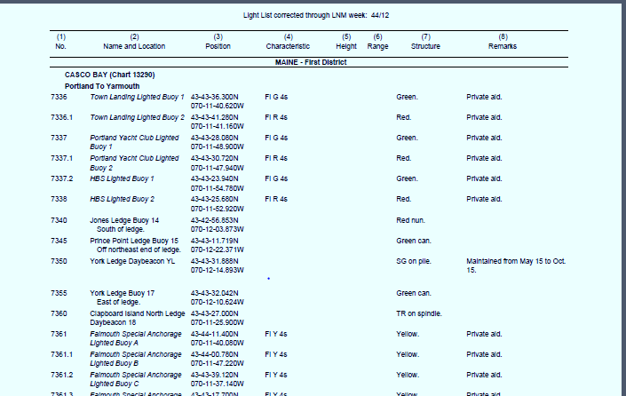
Sample of the Corrected Light List
Notes:
Always use the Corrected Light List that can be accessed on www.uscgaan.com. This document is continuously corrected as LNM Local Notice to Mariners are published.
The last LNM that correct the version that you are viewing shows at the top of every page.

Slide 8
When a PATON is charted, you are certifying that the charted position is on station per Latitude and Longitude on the PATON’s permit.
You are also certifying that the symbols and abbreviations appearing on the NOAA chart are also correct and reflect the information on the PATON’s permit.
Notes:
Private Aids that have a LLNR – Light List Numbers may also be charted on a NOAA Chart.
If so, you are certifying that the symbols and abbreviations on the NOAA Chart are correct and correspond to the entry in the Light List, and, most important, match the PATON’s permitted specifications.
Open/CPN Charts are available on the Navigation Systems Web Site. These charts are updated twice a month.
In order to insure the Coast Guard that your report is correct, you have to be using these documents to check each Private Aid.
Note that it is always more efficient to check the Light List and the Chart prior to your patrol.
While saving time while on station at the Private Aid, it points out potential problems at the aid that need to be resolved.

Slide 9
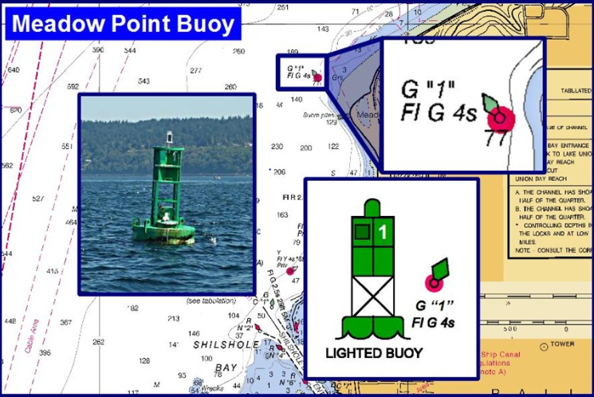
Plot the observed FIX to confirm
the accuracy of the position.
Observation of
the PATON
Confirm the light
characteristic at
night
Symbols and
abbreviations
on the NOAA
Chart.
Reference to the
IALA-B Aid to
Navigation System
for a lighted aid.
Notes:
Here are a photo and a diagram of a lighted port side aid to navigation. Also demonstrated is the charted symbols and abbreviations for the aid.
This data must match the Light List and, most importantly, the PATONs permitted specifications.
Plan to check the charted Latitude and Longitude to the permitted position of each aid. Many time the charted position does not match even though the permitted and Light List positions do match.

Slide 10
Off-Station Criteria
Lateral Aid is within a 50 foot watch circle.
Fixed Aid is within a 25 foot watch circle.
Regulatory Aid is within a 300 foot watch circle.
  Regulatory PATONs should not be located in the navigable channel.
Notes:
As I explained on a previous slide, the off station criteria are as follows:
For Lateral Aids – position must be observed within a 50 foot watch circle from the permitted position of the aid.
For Fixed Aids – position must be observed within a 25 foot watch circle from the permitted position of the aid.
For Floating Regulatory aids – position must be observed within a 300 foot watch circle from the permitted position of the aid.

Slide 11
When the PATON is a lateral aid, you are certifying that the aid conforms to the IALA-B Aid to Navigation System with the correct color, numbering, shape and retro-reflective material.
Notes:
When you are observing a lateral aid, you are certifying that the aid conforms to the IALA-A B Aid to Navigation System.
Items such as aid color, numbering or lettering, color of numbers and letters, aid shape, the retro-reflective material and if lighted, the light color and the flashing characteristics for the type of aid.

Slide 12
Plot your observed fix for lateral aids on a NOAA chart to verify that the aid is on station and to prove that your fix is accurate.
This is an important part of a lateral aid check but is not required for a regulatory aids. Regulatory aids are only problematic when they are deployed within a navigable channel. Most regulatory aids are not charted nor listed in the Light List.
When a lateral PATON’s charted position differs from the Light List and the PATON is charted, your 7054 AV PATON Verification Report will initiate a LNM to notify mariners of the problem.
Notes:
You will need to plot your observed fix for each lateral aid and verify that the aid is within the Off Station criteria using the Vertical and Horizontal Error Calculator in order to verify that the lateral aid is either on or off station.
It is not necessary to perform this verification for Regulatory buoys.
When a lateral aid is reported off station, your report may initiate a LNM to correct its position in the Light List and the NOAA Chart.
Not all private aids are listed in the Light List and is charted by NOAA.

Slide 13
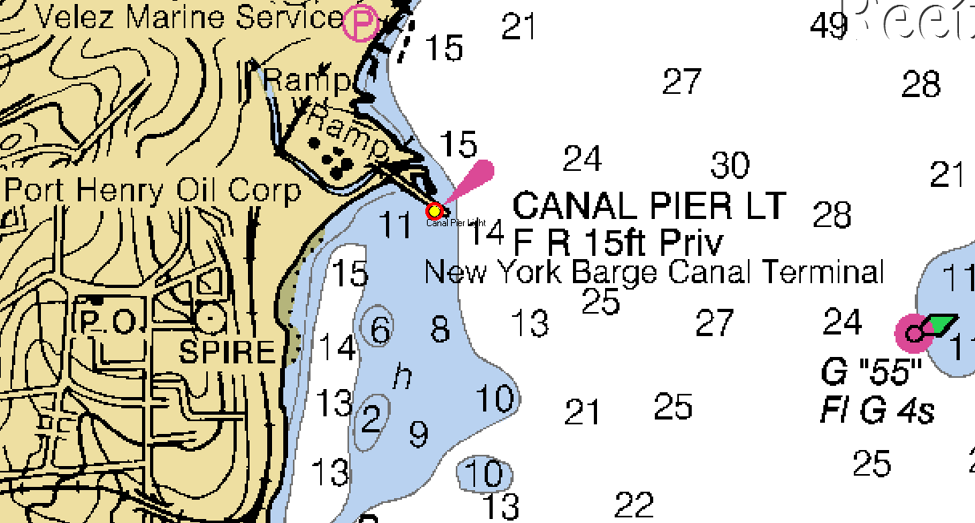
Open/CPN NOAA Chart
This symbol shows that the
Latitude and Longitude plot
of the observed FIX confirms
that the PATON is on station.
Notes:
This chartlet indicates the proper attitude of the copy used for an aid. It can be either vertical or slanted.
Fixed aids have vertical lettering to indicate that the aid is fixed.
Floating aids have slanted lettering to show that the aid is floating.
There are examples of both these conditions shown on the slide.

Slide 14
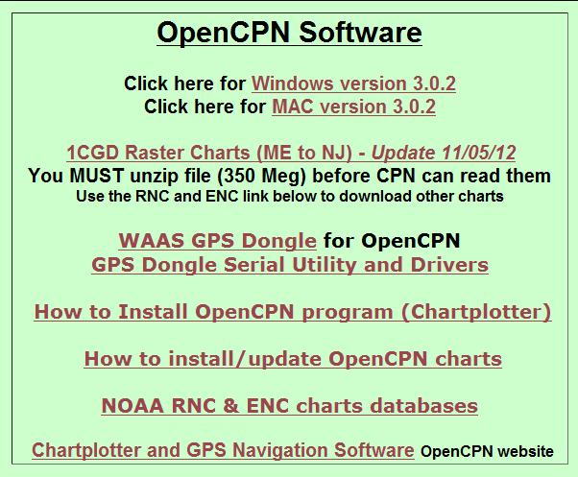
Access to “free” Open/CPN Software
Notes:
Access to Open/CPN charts can be found on the www.uscgaan.com web site.

Slide 15
Use the Vertical and Horizontal Error Calculator which is available on the D1NR Navigation Systems Web Site at:
www.uscgaan.com
Use this tool to calculate the number of feet that an aid is off station and its True direction from its permitted position.
Notes:
Use the Vertical and Horizontal Error calculator to determine the number of feet that your observed Latitude and Longitude is off from the PATON’s permitted Latitude and Longitude. This tool also indicates the True direction from the PATON’s permitted position to your observed position.
Using this tool makes your Off Station report more credible.

Slide 16
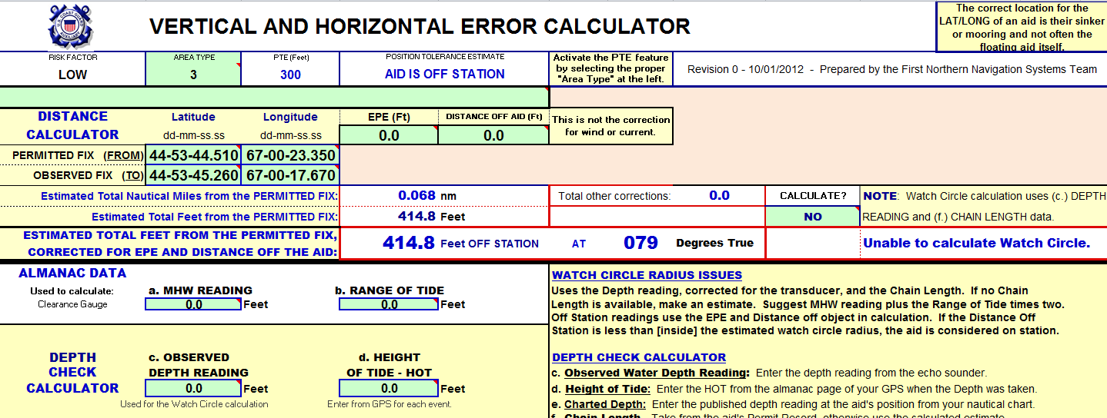
Vertical and Horizontal Error Calculator
Your accuracy is critical to your credibility!
Notes:
Here is an example of the distance that a regulatory aid is off from it permitted position.
Since the regulatory buoy’s position is off more that 300 feet, it would be reported as off station. Report this details in the “AV Observation” filed on your 7054 AV Verification Report.
Note that regulatory buoys are generally not listed in the Light List nor are they charted. However, many exclusion aids surrounding military installations, power stations and airports are charted and listed in the Light List.

Slide 17
When the PATON is a regulatory buoy, you are certifying that it conforms to the standard marking specified for a Regulatory Buoy
– a white aid with two orange bands and black lettering and symbols. This is reported even when the PATON’s permit has a different specification.
Commonly, these aids are used for marking swim areas, no wake and speed zones, hazards, exclusion areas, etc.
Notes:
Regulatory aids should be white cans or square daymarks with two orange bands with a black symbol and black lettering.
The next slide shows example of these aids.

Slide 18
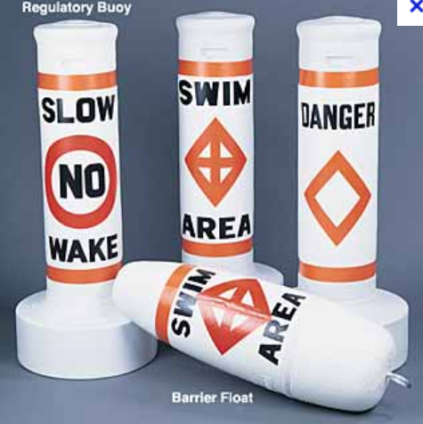
Notes:
Here are four examples of Regulatory buoys.

Slide 19
Regulatory aids are not used for navigational purposes.
They normally reflect ordinances and laws that are enacted locally.
Notes:
Regulatory aids are not used for navigational purposes.
They reflect local ordinances and laws enacted by local municipalities.

Slide 20
When the aid is used for a special purpose, you are certifying that it is yellow with black letters.
These aids typically mark mooring area boundaries, aquaculture facilities and aids, sail race marks, etc.
Notes:
When an aid is used for a special purpose, they should be yellow with black lettering.
These aids mark mooring areas, mark race courses, mark data collection buoys and aquacultural facilities.
The leased area of an aquacultural facility should be marked by four yellow cans with black lettering.
If the facility abuts a navigable channel, the aids ajacent to the channel should be lighted.

Slide 21
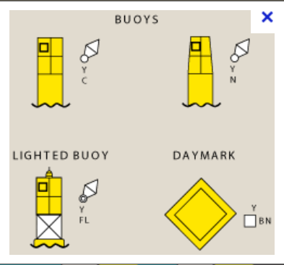
Notes:
Here are the typical aids used for special purposes.
When lighted, they should show yellow or amber lights.
Note that the charted symbol is a white diamond.

Slide 22
When you are not sure whether a problem exists, discuss it with your
ADSO-NS or DSO-NS.
Protect the credibility of the AVs in First Northern.
Notes:
If you are not sure of the problem that you are observing, call you ADSO or the DSO for assistance before you guess and report it.
Remember, that you reports are going directly to the Coast Guard and the owner this year and you want to right.
Your reports receive Coast Guard visibility. Protect your credibility.

